Slide 1

Visión por Computador
Domingo Mery
Departamento de Ciencia de la Computación
Escuela de Ingeniería
Universidad Católica de Chile
Object Detection
[ Capítulo 3 ]

Slide 2
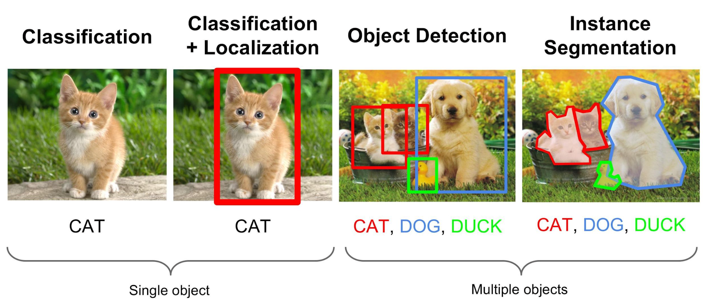

Slide 3
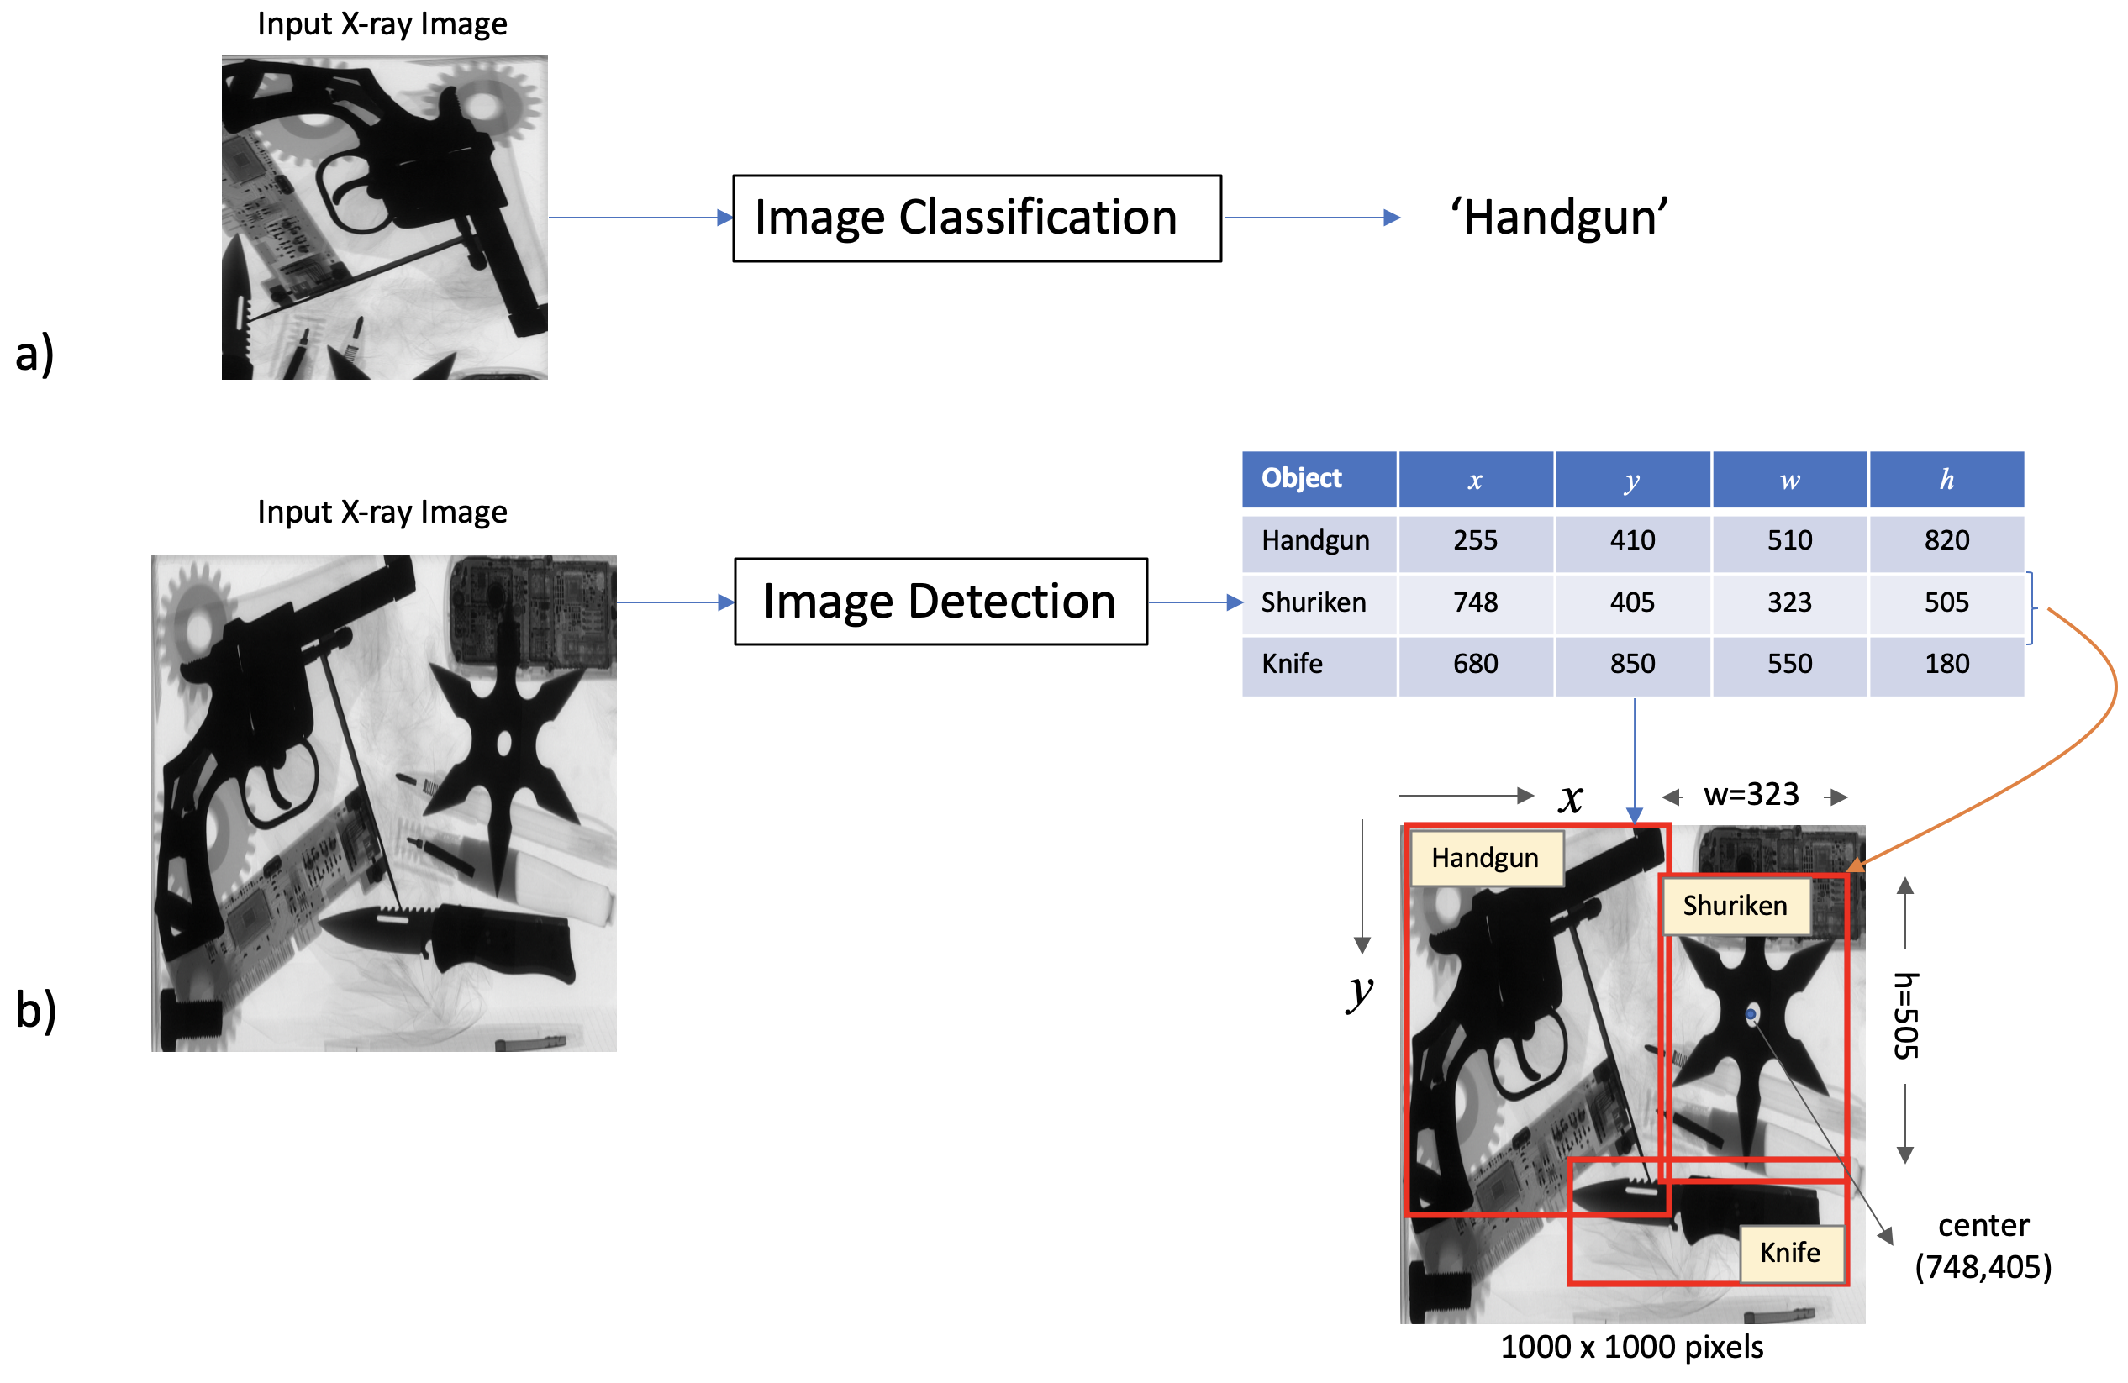

Slide 4
Slinding Windows con CNN

Slide 5
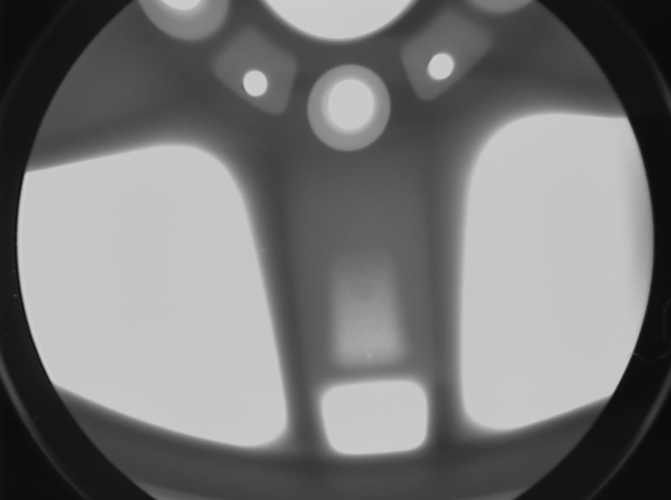

Slide 6
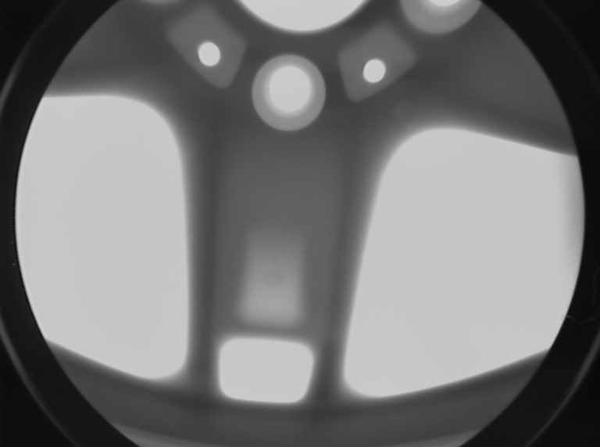

Slide 7
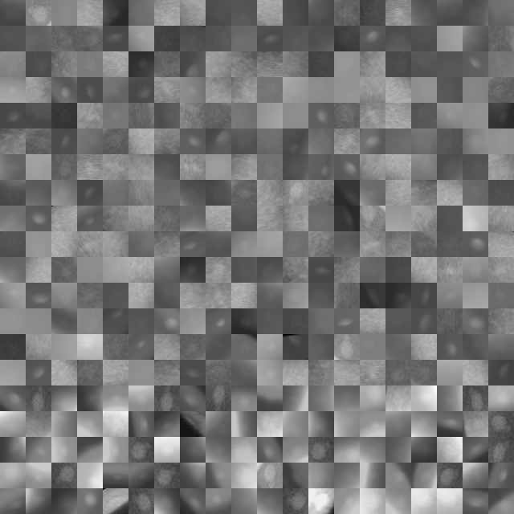
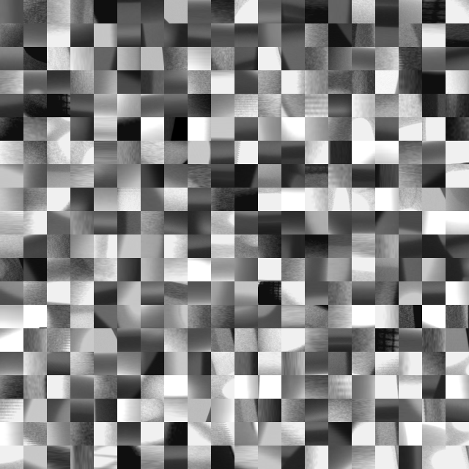
CNN
Training
DEFECTS
NO-DEFECTS

Slide 8
Sliding
Windows

Slide 9
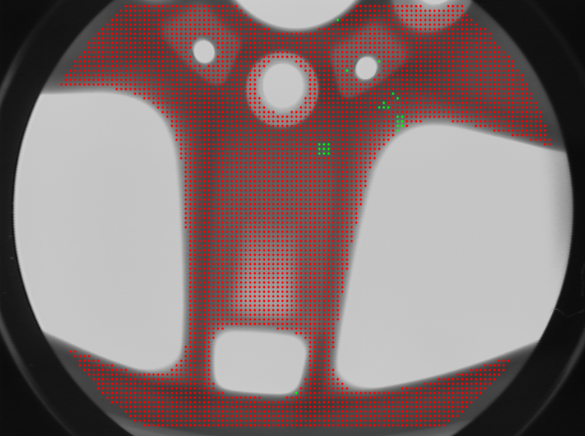

Slide 10
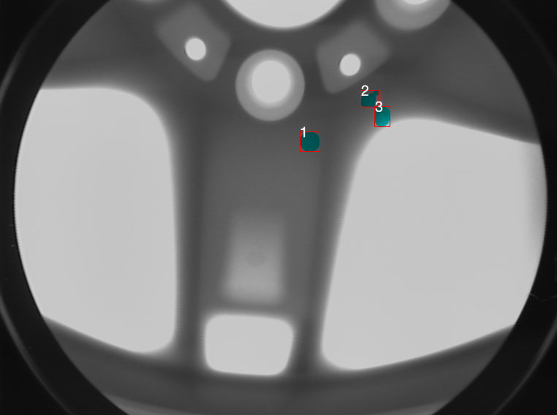

Slide 11
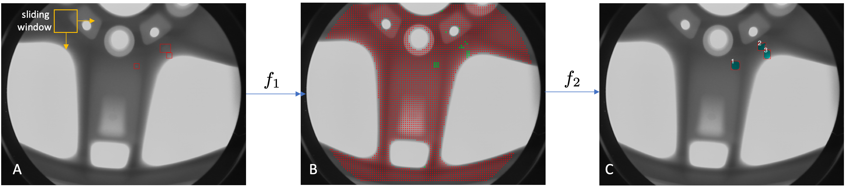
Sliding-Windows

Slide 12
RCNN

Slide 13
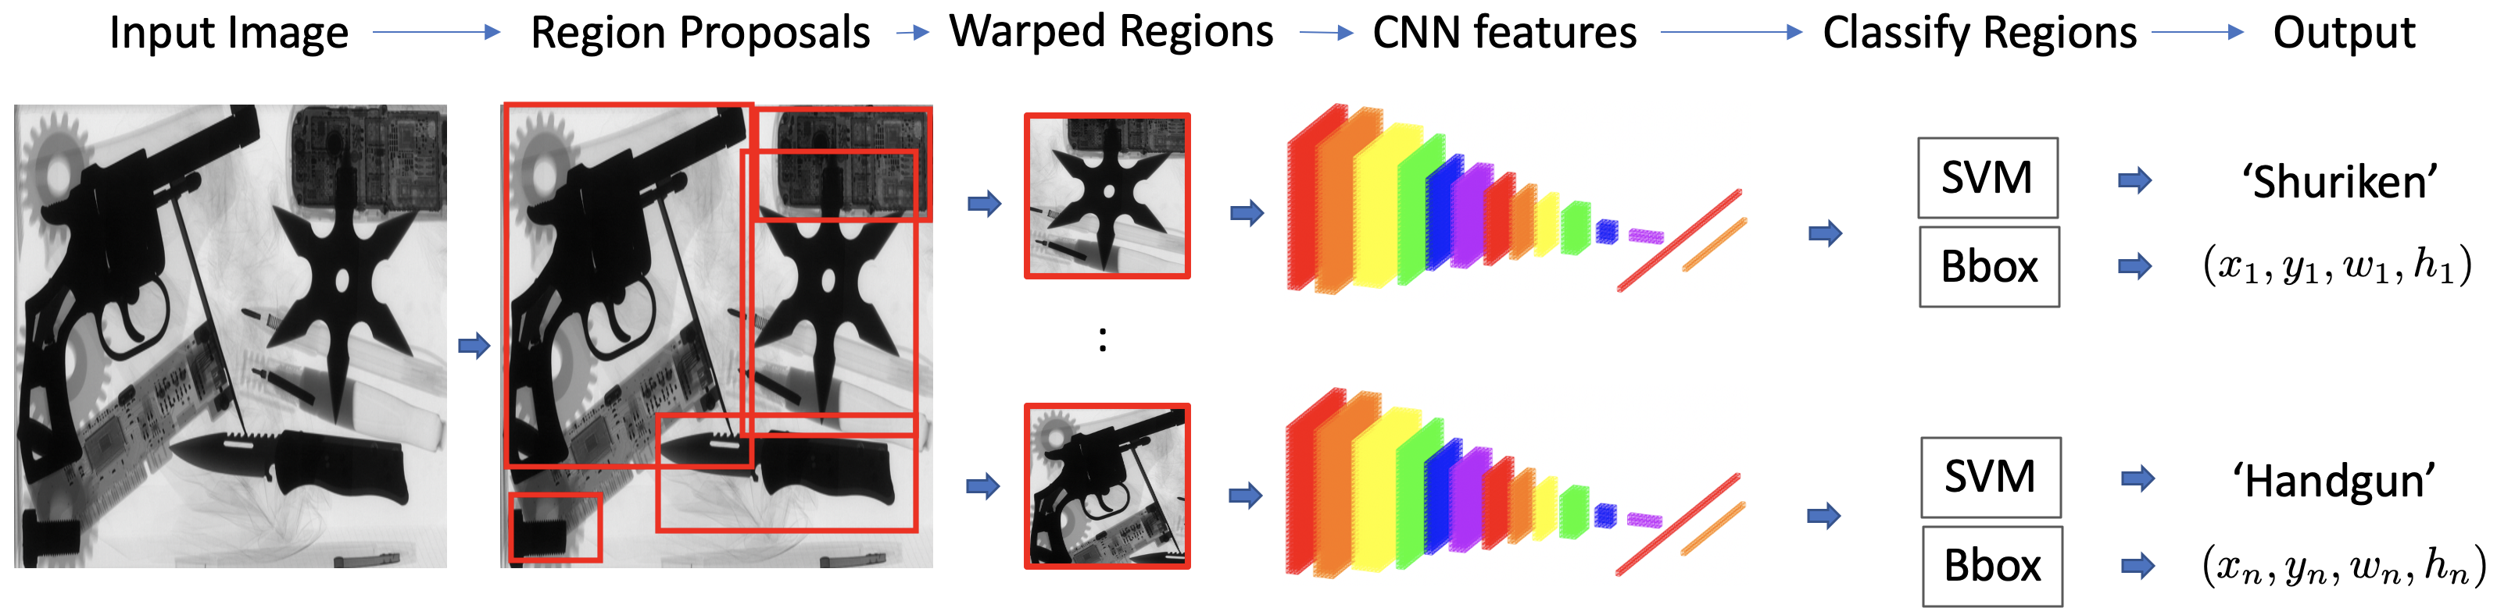
RCNN

Slide 14
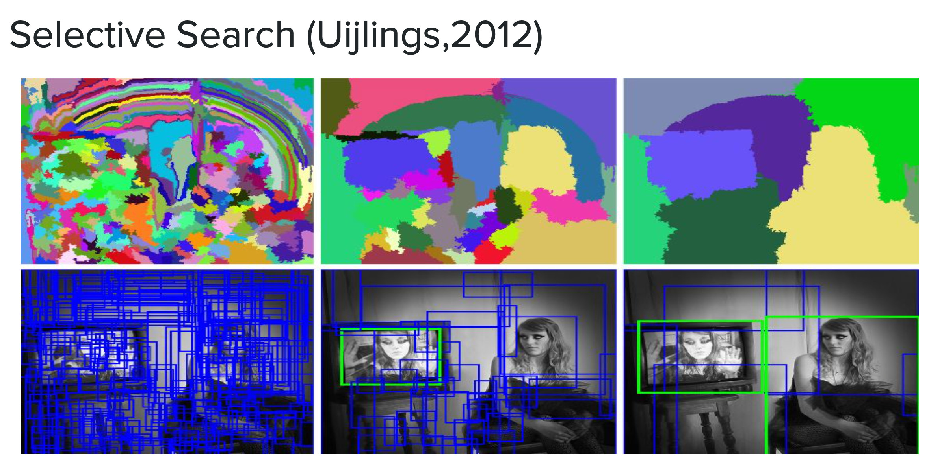

Slide 15
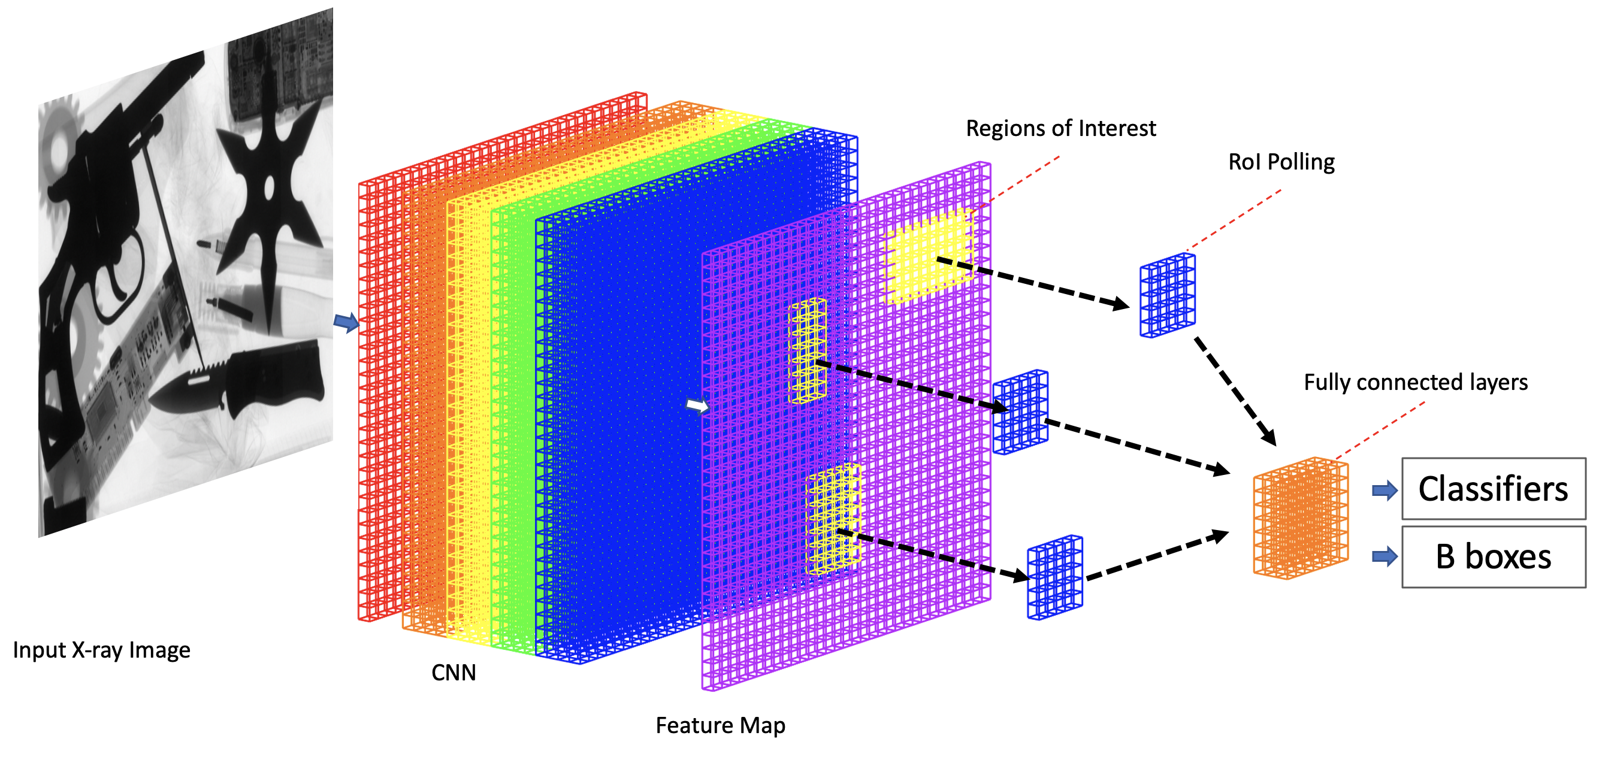
Fast-RCNN

Slide 16
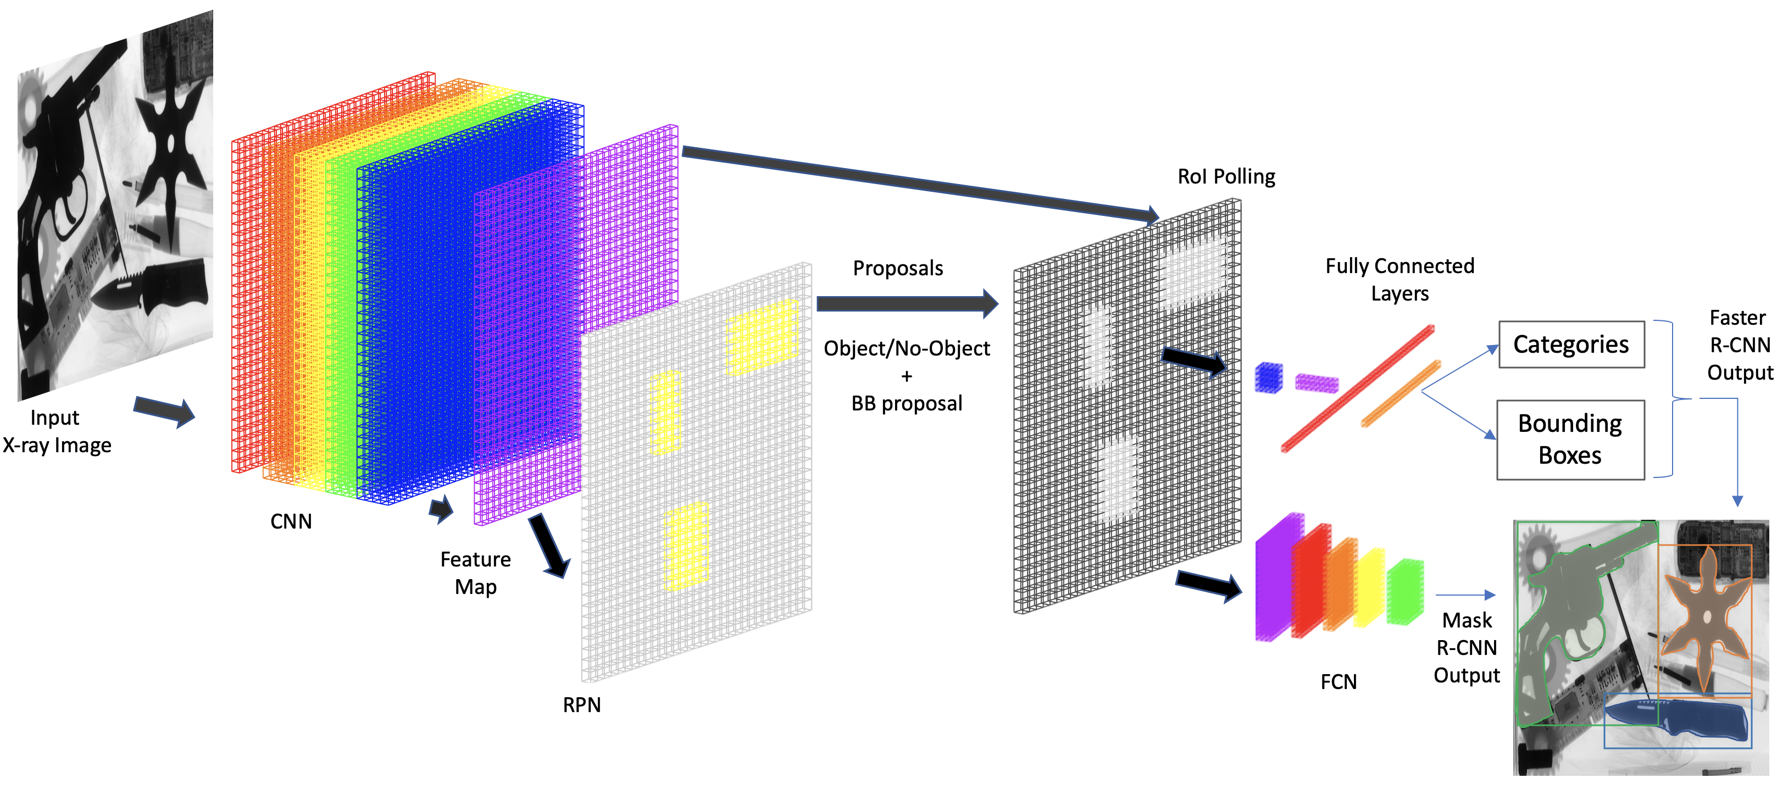
MaskFaster-RCNN

Slide 17
YOLO

Slide 18
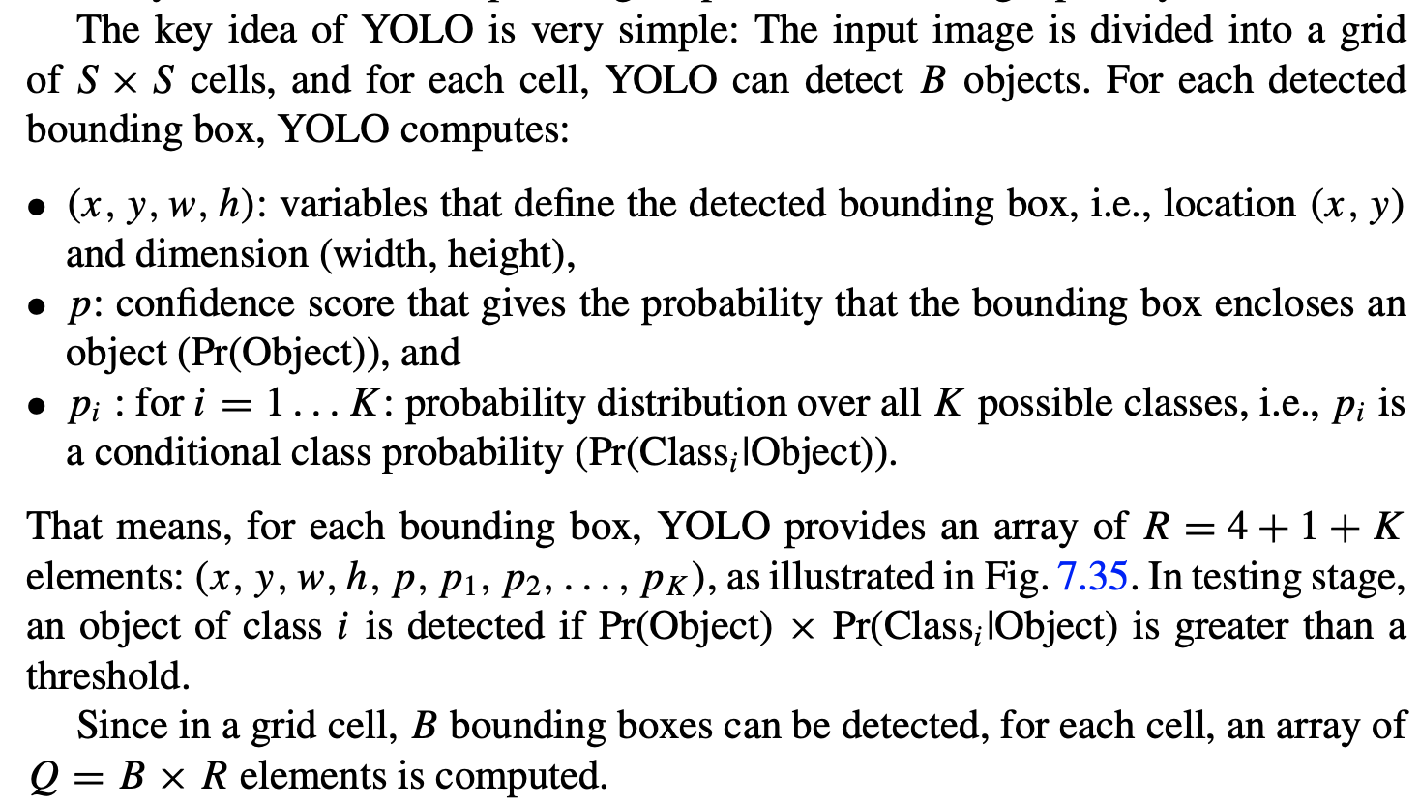

Slide 19
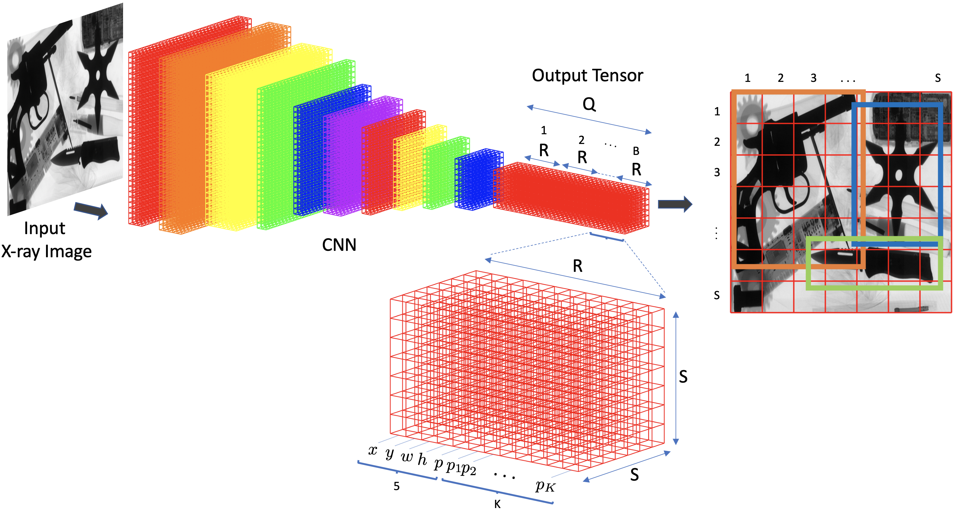
YOLO

Slide 20
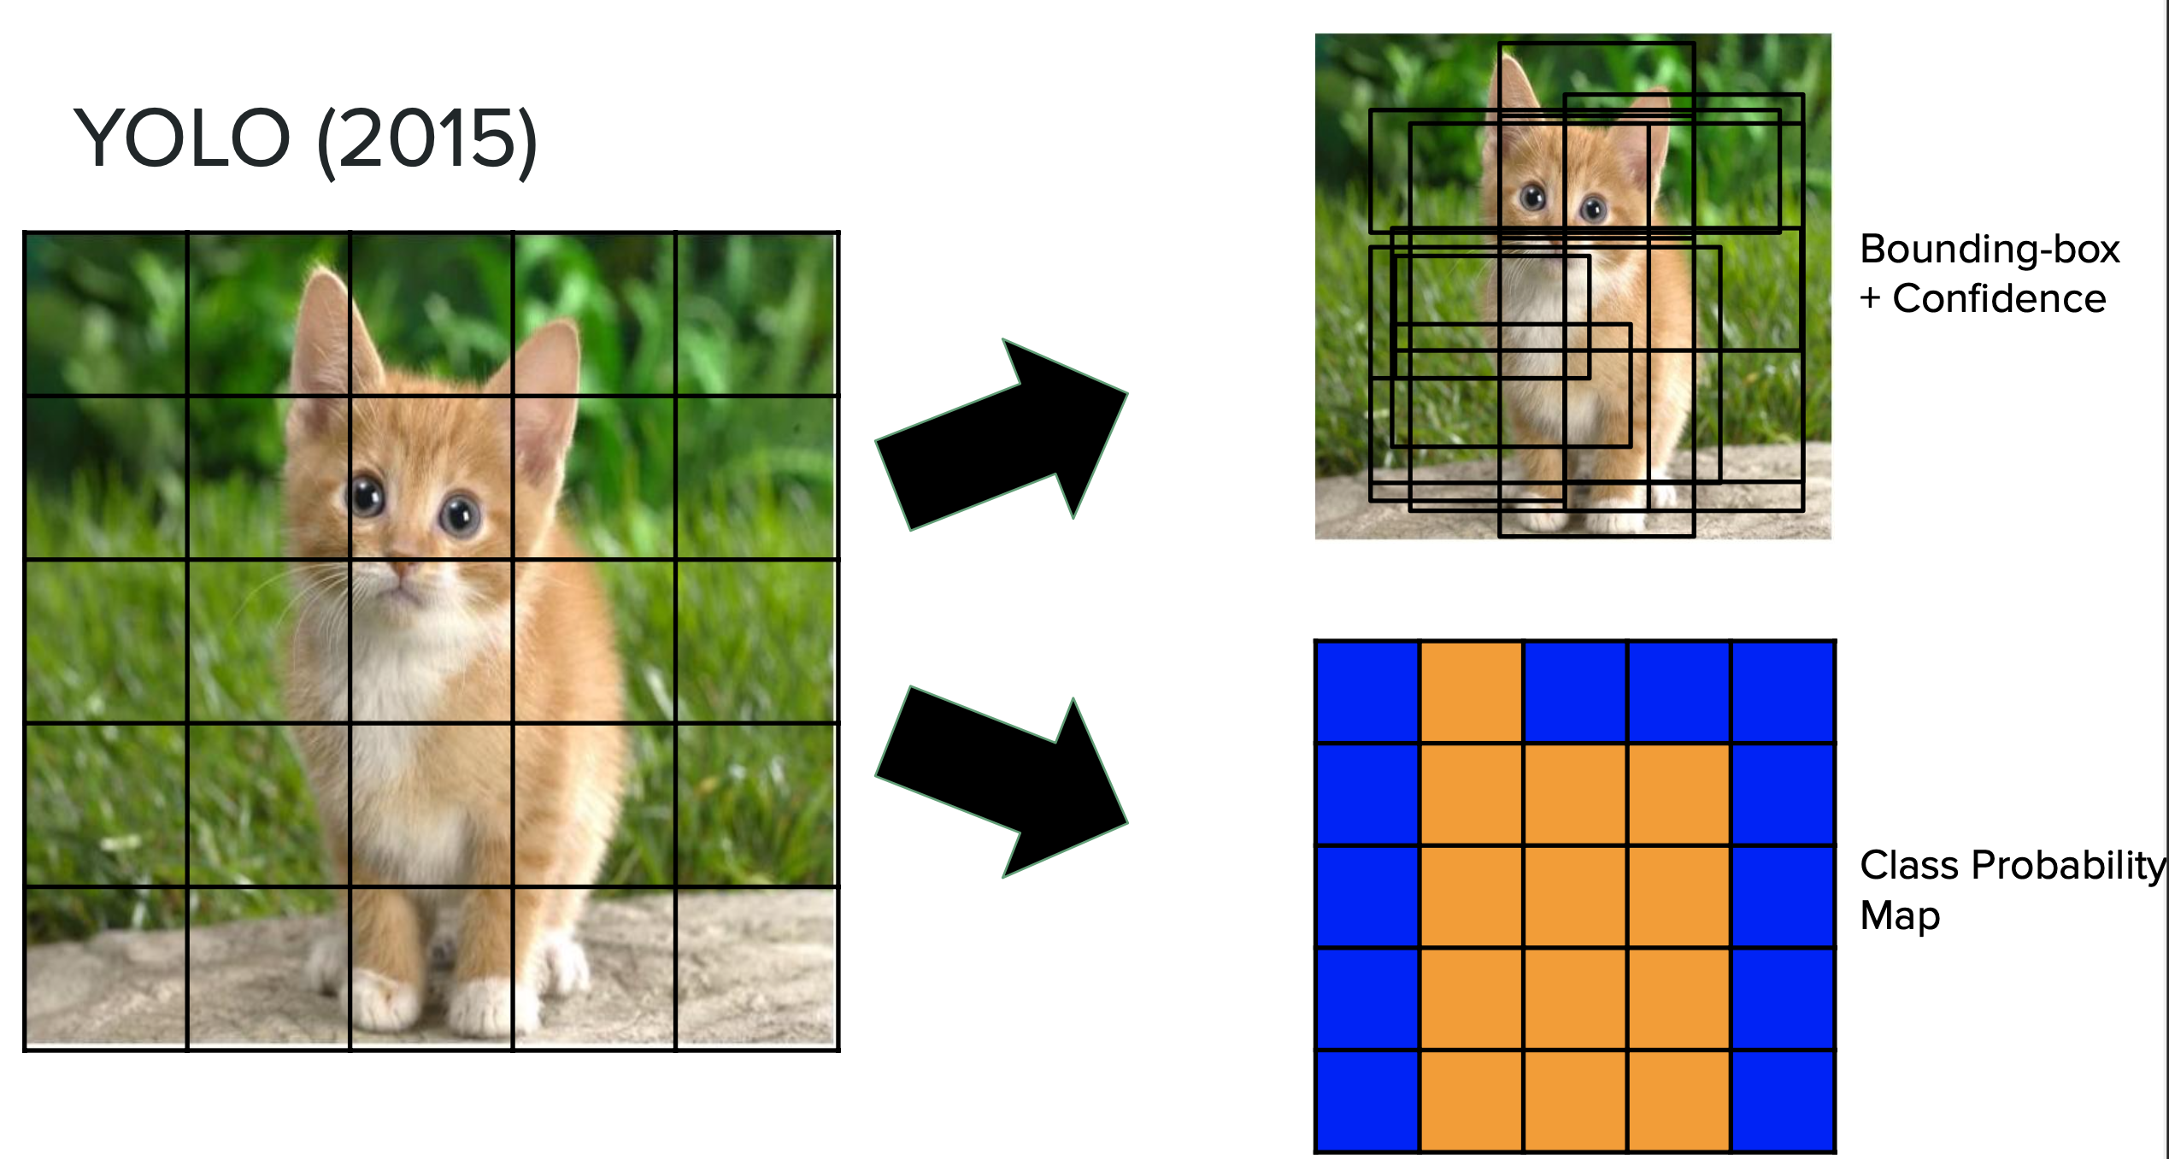
YOLO

Slide 21
Implementación de YOLOv8
(Ejemplo: Detección de ojos y boca)

Slide 22
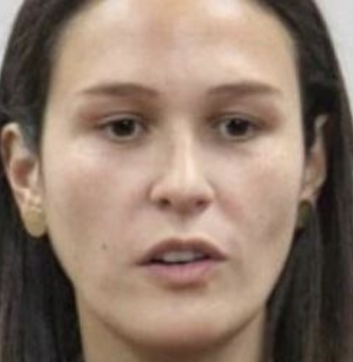
Object
Detection

Slide 23
Para la implementación de YOLOv8…
Se necesita:
Base de datos (imágenes)
Anotaciones (bounding boxes + clases)
Formatos adecuados
Definición de Train/Val/Test
Definición de archivo YAML

Slide 24
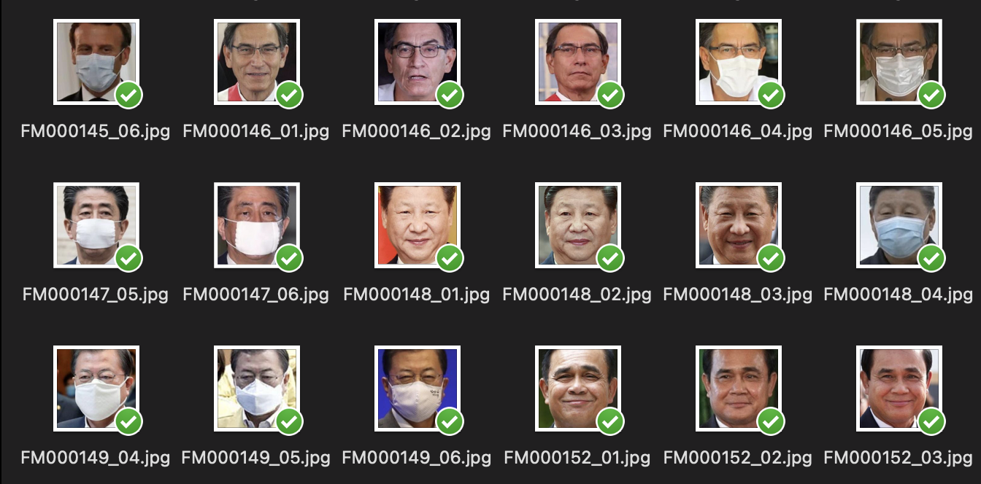
1. Base de datos

Slide 25
2. Anotaciones
x
FM000048_02.jpg
y
(x1,y1)
(x1,y1)
Ojos:
Clase 0
(x2,y2)
(x2,y2)
(x1,y1)
Boca:
Clase 1
(x2,y2)

Slide 26
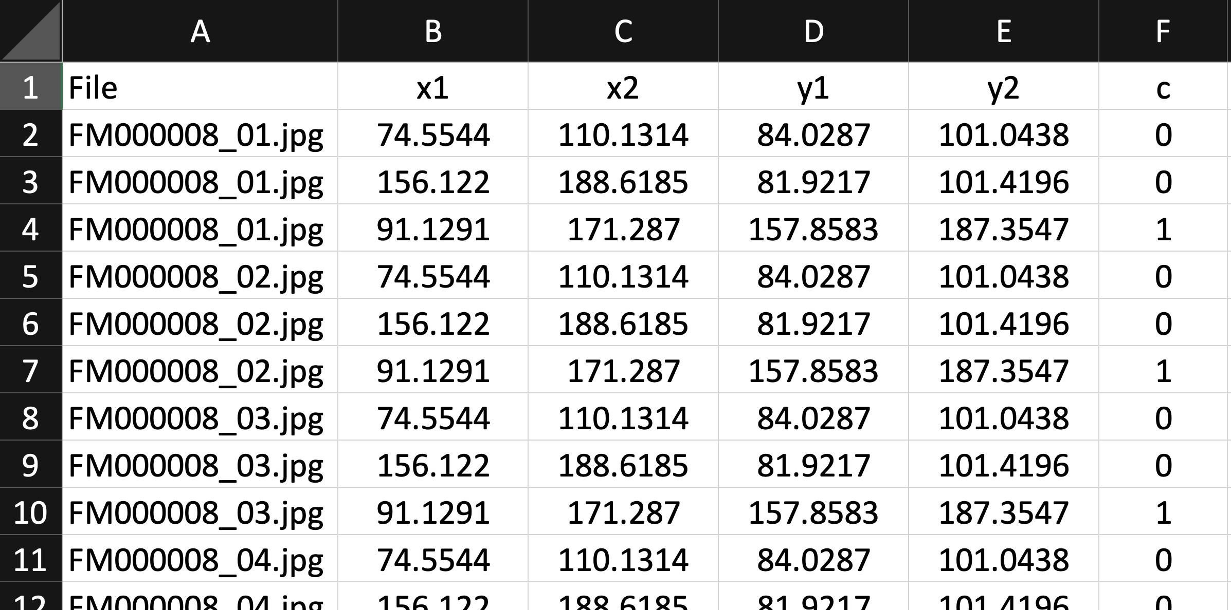
2. Anotaciones
boundingbox.csv

Slide 27
3. Formato
boundingbox.csv
File x1 x2 y1 y2 c
:
FM000048_01.jpg | 156.122 | 188.6185 | 81.9217 | 101.4196 | 0
FM000048_01.jpg | 91.1291 | 171.287 | 157.8583 | 187.3547 | 1
FM000048_02.jpg | 74.5544 | 110.1314 | 84.0287 | 101.0438 | 0
FM000048_02.jpg | 156.122 | 188.6185 | 81.9217 | 101.4196 | 0
FM000048_02.jpg | 91.1291 | 171.287 | 157.8583 | 187.3547 | 1
FM000048_03.jpg | 74.5544 | 110.1314 | 84.0287 | 101.0438 | 0
FM000048_03.jpg | 156.122 | 188.6185 | 81.9217 | 101.4196 | 0
x
FM000048_02.jpg
y
:
(x1,y1)
(x1,y1)
Ojos:
Clase 0
FM000048_02.txt
N = 256
(x2,y2)
(x2,y2)
c xn yn wn hn
(x1,y1)
Boca:
Clase 1
0 0.3607 0.3615 0.1390 0.0665
0 0.6733 0.3581 0.1269 0.0762
1 0.5125 0.6742 0.3131 0.1152
(x2,y2)
M = 256
Por cada imagen con objetos <nombre_imagen>.jpg se necesita un archivo de texto <nombre_imagen>.txt

Slide 28
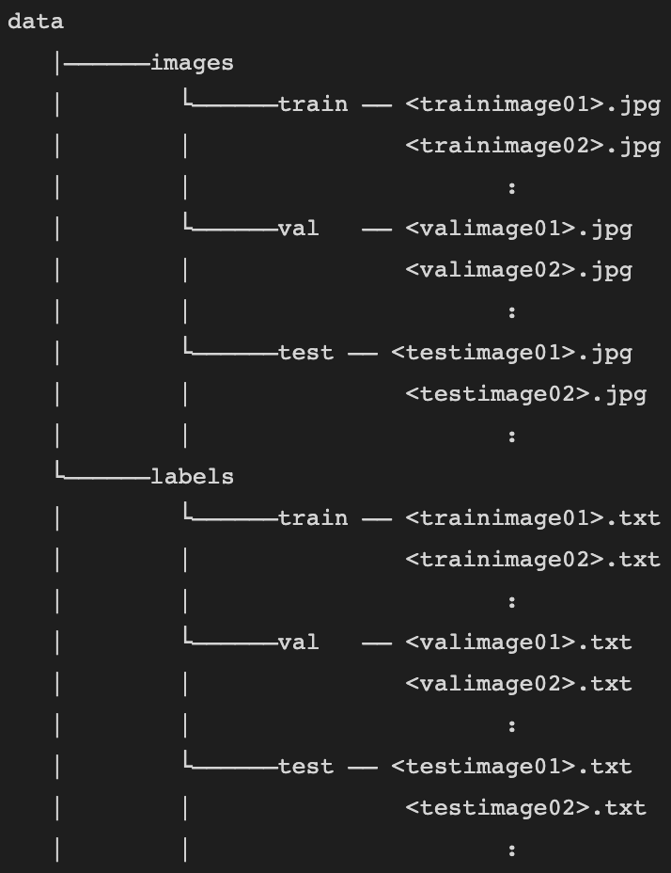
4. Definición de
Train/Val/Test

Slide 29
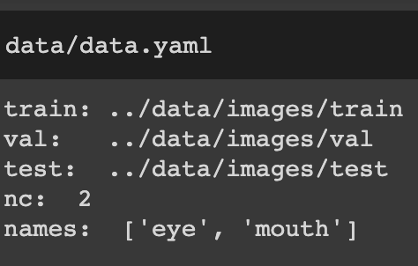
5. Definición de archivo YAML
(archivo de texto: data.yaml)

Slide 30
Ahora estamos listos para entrenar y probar YOLOv8!

Slide 31
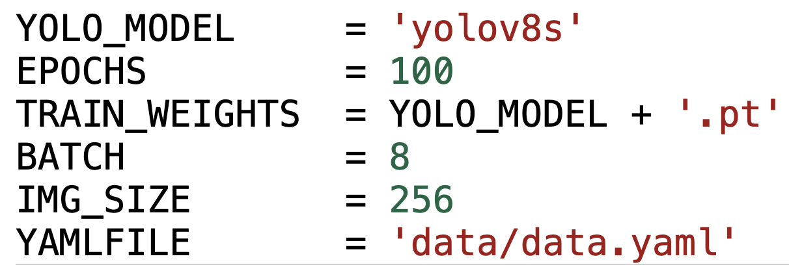
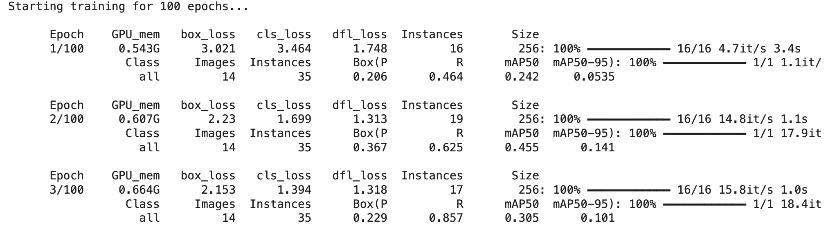
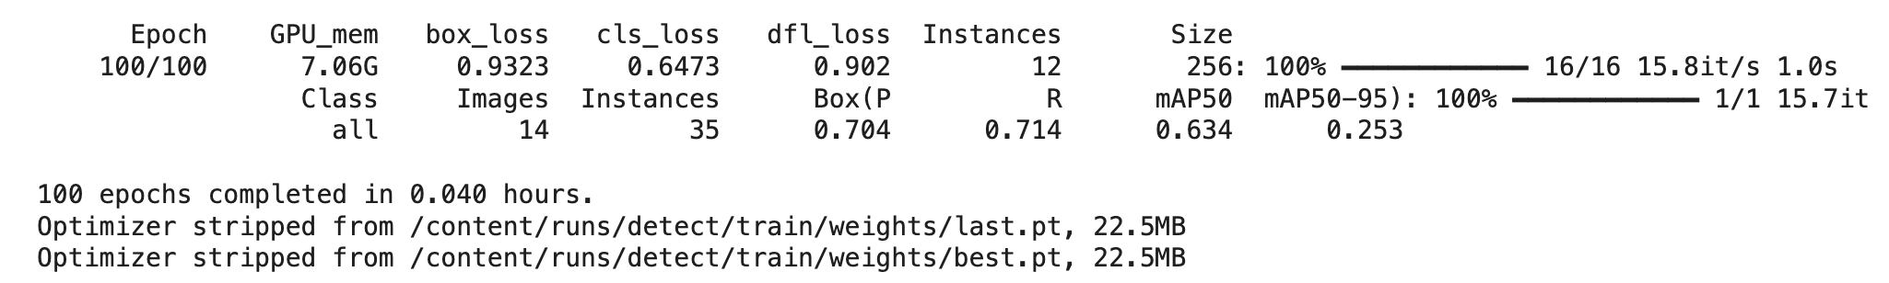
Training
:
Pesos del entrenamiento

Slide 32
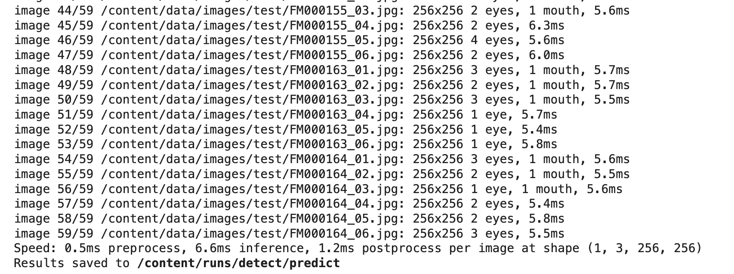
Testing
Pesos del entrenamiento
:
Resultados

Slide 33
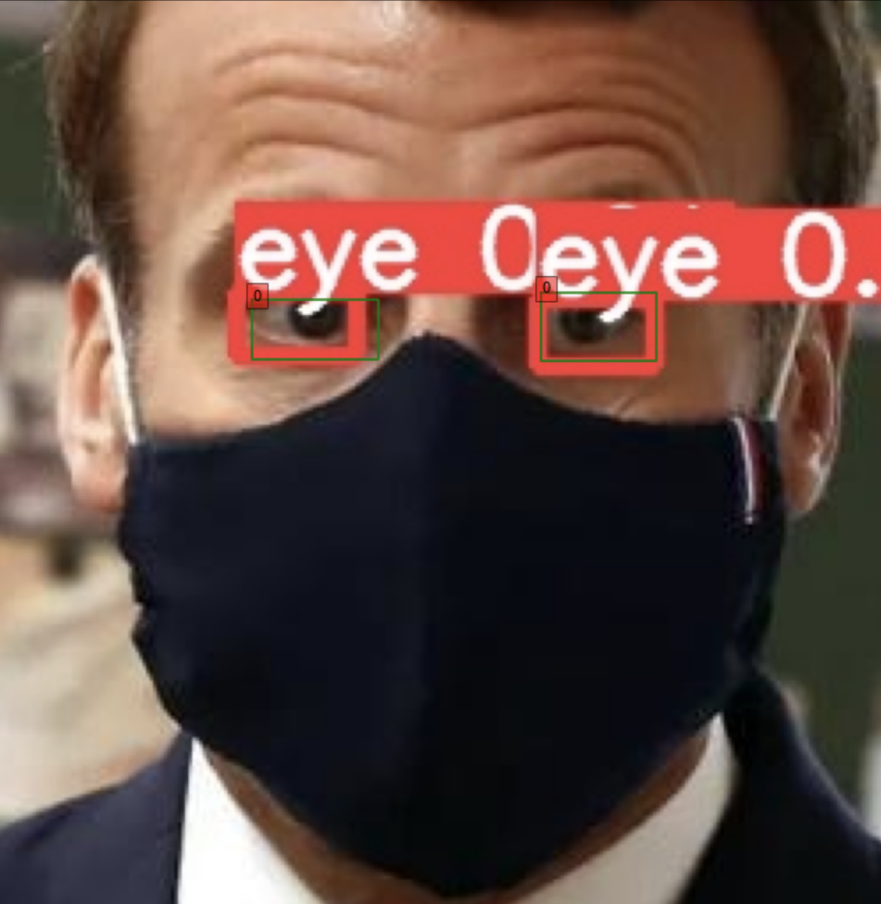
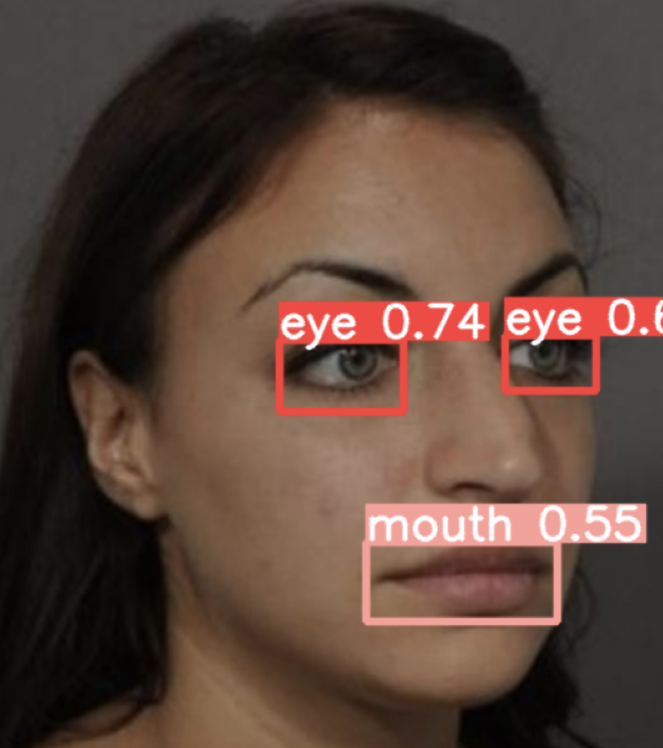

Slide 34
Ejemplo con pesos pre-entrenados

Slide 35
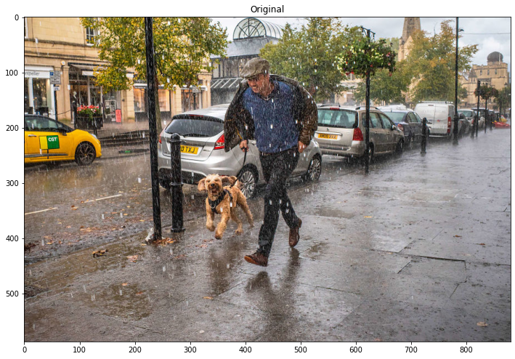

Slide 36
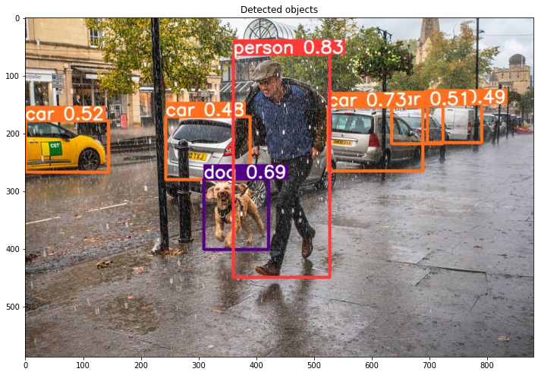

Slide 37
Ejercicio: Detección de Mascarilla

Slide 38
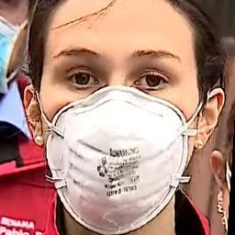
Detección de Mascarilla
Object
Detection

Slide 39
Tracking

Slide 40
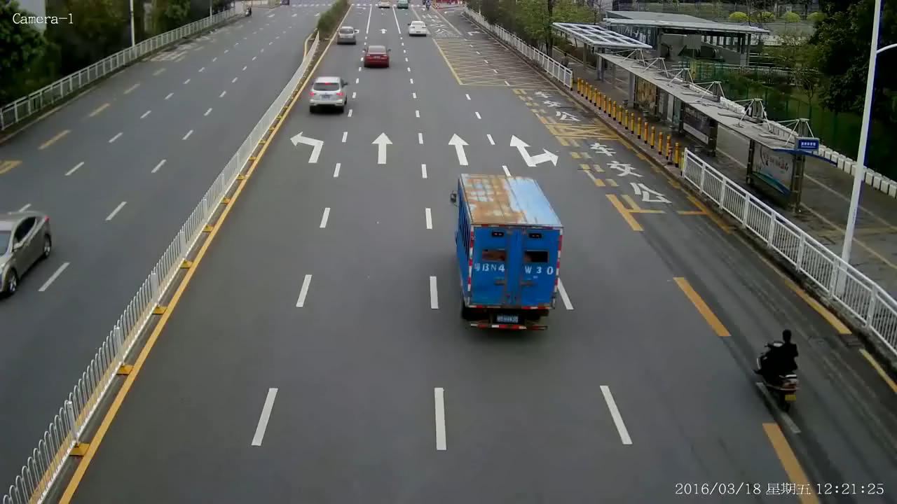

Slide 41
METRICS (es necesario medir la calidad de la detección)

Slide 42


How many of the predictions were defects.
How many of the defects were predicted.

Slide 43
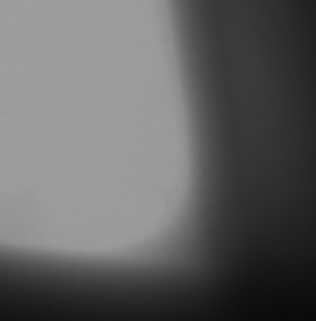
Example
How many of the predictions were defects.
How many of the defects were predicted.

Slide 44
Example
How many of the predictions were defects.
How many of the defects were predicted.
Ground Truth

Slide 45
Example
How many of the predictions were defects.
How many of the defects were predicted.
Ground Truth
Prediction

Slide 46
Example
How many of the predictions were defects.
How many of the defects were predicted.
Ground Truth
Prediction

Slide 47
Example
How many of the predictions were defects.
How many of the defects were predicted.
Ground Truth
Prediction

Slide 48
Example
How many of the predictions were defects.
2/3
How many of the defects were predicted.
Ground Truth
Prediction

Slide 49
Example
How many of the predictions were defects.
2/3
How many of the defects were predicted.
2/4
Ground Truth
Prediction

Slide 50
Example
How many of the predictions were defects.
2/3
How many of the defects were predicted.
2/4
Ground Truth
Prediction

Slide 51
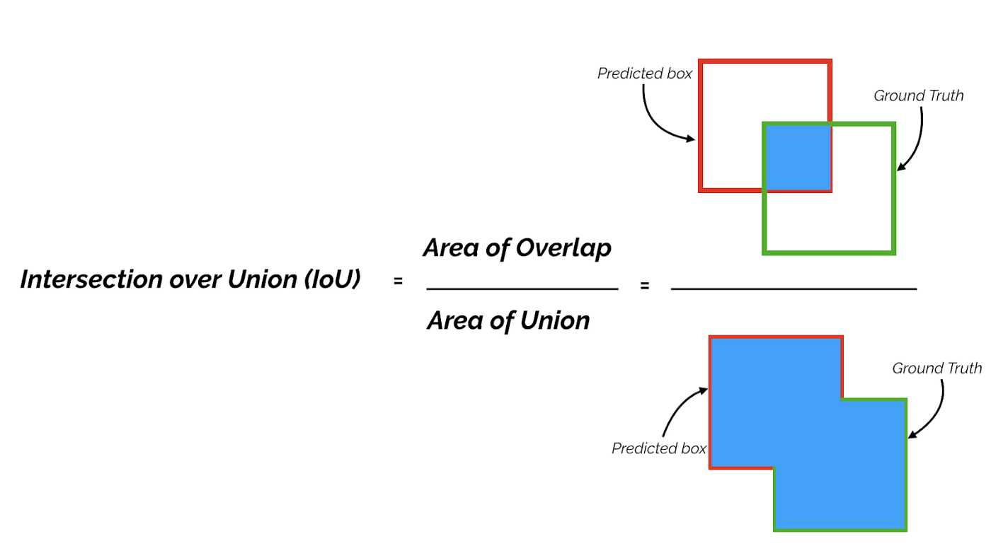
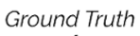
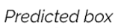
True Positive if IoU >
© Shivy Yohanandan, Towards Data Science

Slide 52
True Positive if IoU >
© Shivy Yohanandan, Towards Data Science

Slide 53
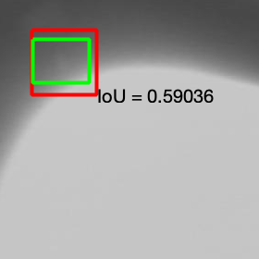
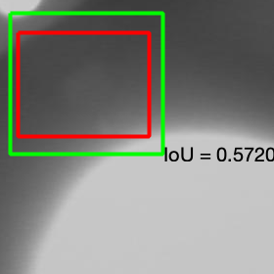
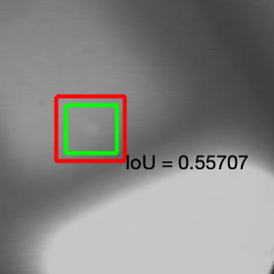
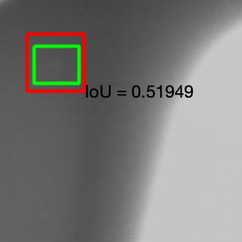
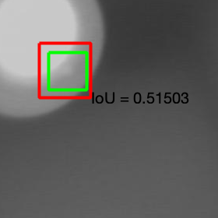
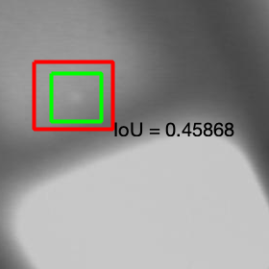
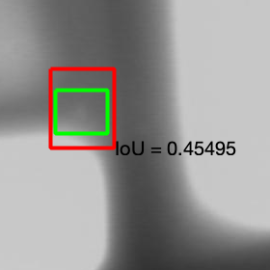
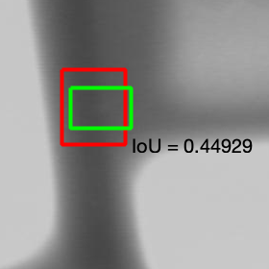
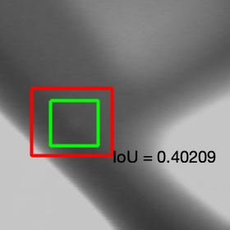
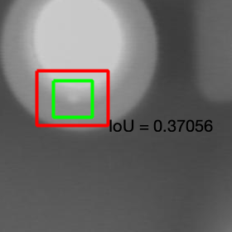
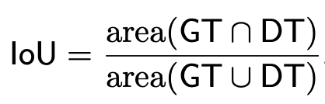
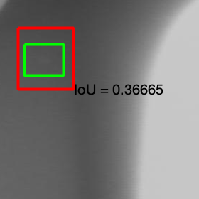
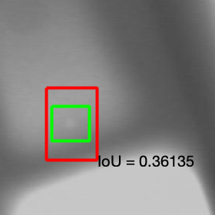
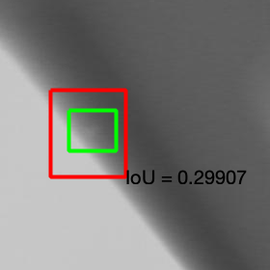
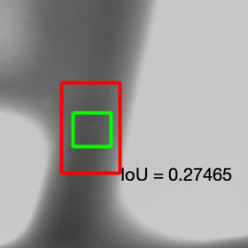

In our experiments, we use

Slide 54

Precision-Recall Curve

Slide 55
Precision-Recall Curve
Average Precision (AP) is the area under the curve
the higher the better
AP = 0.65
Method 1

Slide 56

Precision-Recall Curve
Average Precision (AP) is the area under the curve
the higher the better
AP = 0.81
Method 2

